Slide 1

INTERNATIONAL CONFERENCE ON VLSI AND MICROWAVE AND WIRELESS
TECHNOLOGIES (ICVMWT 2024)
EARLY DETECTION OF MIGRANE DISEASE :
CNN FRAMEWORK
Authors
Prudhvi Raj Budumuru, G. Prakash Babu, A. Uday Kiran,
J.Komali, G. Phani Ram Sai and A. Nageswararao
Vishnu Institute of Technology (Autonomous)
Department of Electronics and Communication Engineering
PRESENTED BY
G.PRAKASH BABU (20PA1A0441)

Slide 2
Contents
Abstract
Objective
Introduction
EEG-DL based Migraine Disease Identification System
CNN Classification Models
Literature Survey
References

Slide 3
Abstract
Global Cancer Statistics 2020 report noticed over three hundred eight thousand new incidence cases and two hundred and fifty thousand new deaths happened across the globe in 2020 alone due to Brain and nervous system disorders.
Hence, early-stage identification and diagnosis of Brain and nervous system disorder is essential.
Migraine is a neurological disorder that is associated with severe headaches and seriously affects the lives of patients.
Diagnosing Migraine Disease (MD) can be laborious and time-consuming for specialists. For this reason, systems that can assist specialists in the early diagnosis.

Slide 4
Objective
Although migraine is one of the most common neurological diseases, there are very few studies on the diagnosis of Migraine Disease (MD), especially electroencephalogram (EEG) and deep learning (DL)-based studies.
The aim is to propose an effective EEG- and DL-based system to support specialists in overcoming the challenges of time-consuming MD diagnosis.

Slide 5
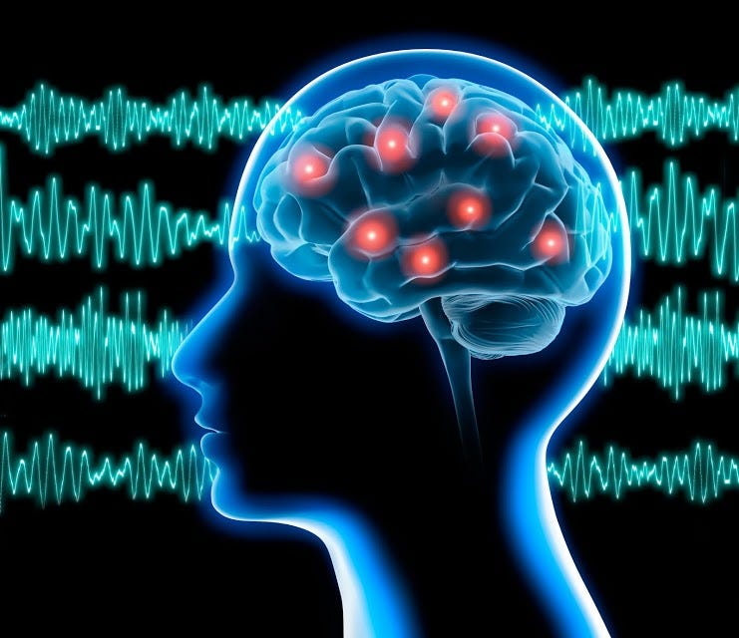
EEG SIGNAL PROCESSING
EEG SIGNAL: An EEG (electroencephalogram) signal records the brain’s electrical activity over time. This electrical activity is generated by firing neurons (nerve cells) in the brain and is crucial for various brain functions.
Electrodes: Small metal discs (electrodes) are attached to the scalp using a conductive gel or paste. These electrodes detect the electrical signals produced by neurons.
2. Amplification: The electrical signals detected by the electrodes are very weak, so they are amplified to make them measurable.
3. Recording: The amplified signals are then recorded over time, creating a continuous waveform known as the EEG signal.
4. Frequency Bands: EEG signals can be analyzed based on different frequency bands, which are associated with different brain activities. The main frequency bands include delta (0.5-4 Hz), theta (4-8 Hz), alpha (8-13 Hz), beta (13-30 Hz), and gamma (above 30 Hz).

Slide 6
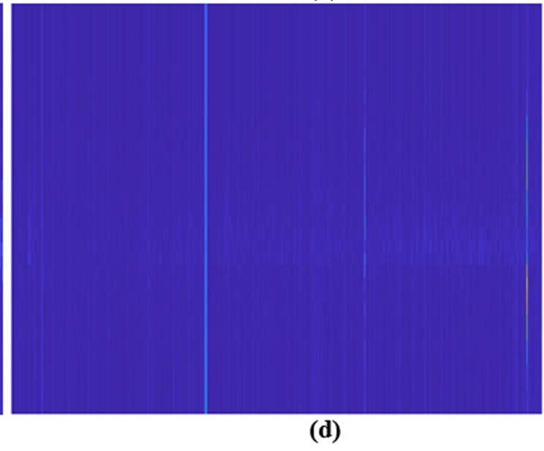

APPLYING TRANSFORM TO EEG SIGNALS
Short-Time Fourier Transform (STFT) is a popular time-frequency analysis method. It is an upgraded version of the Fourier method. It divides signals in the time domain into blocks and evaluates the Fourier transform for each block. Acting like a symmetric band-pass filter,
Applying STFT to EEG signals produces spectrogram images. The transformation is represented by as X(t, f) where 'x(t)' is the signal, and 'w(t)' is the window function. The length of windows is uniform, assuming the signal is stationary within each window time.
Figure . (b) STFT images of healthy control group.

Slide 7
CNN Classification Models
Convolutional Neural Networks (CNNs) are popular for feature extraction and classification, especially in image and signal processing.
CNN consist of layers like convolution, pooling, and fully connected layers.
AlexNet, ResNet50,VGG16 commonly used CNN architectures for MD disease classification.
Additionally, a custom-designed DCNN model will propose and fine-tuned for optimal performance. The DCNN model includes layers like Input, Convolution, ReLU, Max Pooling, Fully Connected layer ,Classification.
Deep Learning (DL) is a smart way to analyze data using neural networks. Unlike traditional methods, DL learns features automatically, making it superior. DL, especially using Convolutional Neural Networks (CNN), is vital for classifying EEG signals and diagnosing neurological diseases.
In the upcoming classification phase, we'll use well-known CNN architectures like AlexNet, ResNet50, and SqueezeNet, along with a recommended DCNN model, to compare their performance.

Slide 8
DCNN stands for "Deep Convolutional Neural Network." It is a type of artificial neural network designed for processing and analyzing visual data, with a focus on tasks like image classification, object detection, and image segmentation. The "deep" in DCNN refers to its multiple layers, allowing it to automatically learn hierarchical features from the input data.
AlexNet, as a deep convolutional neural network (DCNN) architecture, is primarily designed for image classification tasks. It excels at tasks such as image recognition and classification
ResNeSt (Residual Neural Network with Squeeze-and-Excitation in Nest) is a deep neural network architecture designed for image classification tasks. ResNeSt builds upon the ResNet (Residual Network) architecture and incorporates the concept of Squeeze-and-Excitation (SE) blocks for better channel-wise feature recalibration.

Slide 9
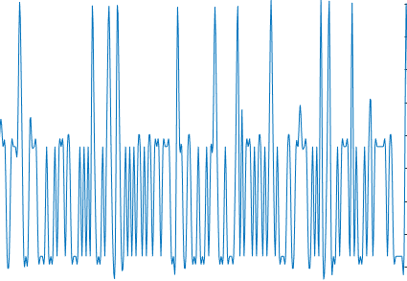
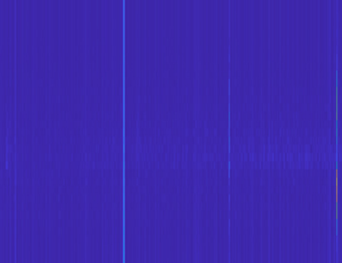
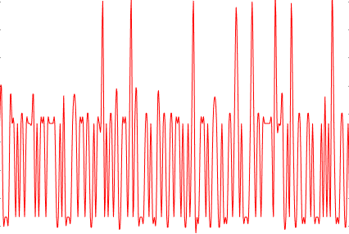
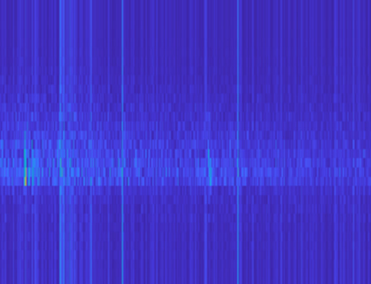
Flow diagram for the proposed migrane detection model
EEG Signal-Healthy Sample
Spectrogram-Healthy
STFT
CNN
Healthy
EEG Signal -Migraine Sample
Spectrogram-Migraine
Migraine
STFT

Slide 10
Network Architecture for proposed model
Input Layer (227): - This represents the input data, which has a size of 227. This could be the width or height of an image, for example.
Convolution (AxB): - Convolutional layers apply a set of filters (in this case, A filters) to the input data. - The “AxB" notation indicates that each filter has a size of AxB. This means the convolution operation involves sliding these filters across the input data to extract features.

Slide 11
ReLU (Rectified Linear Unit): - ReLU is an activation function commonly used in neural networks. - It introduces non-linearity by replacing all negative values in the output with zero. - Mathematically, ReLU(x) = max(0, x).
Pooling: - Pooling layers downsample the spatial dimensions of the input. - Common pooling operations include max pooling, which takes the maximum value from a group of values, or average pooling, which takes the average.
Fully Connected Layers (128, 64, 2): Fully connected layers connect every neuron in one layer to every neuron in the next layer. The numbers 128, 64, 2 represent the number of neurons in each fully connected layer. Typically, the last fully connected layer has as many neurons as the number of classes in a classification task. In this case, there are 2 neurons, suggesting a binary classification task.

Slide 12
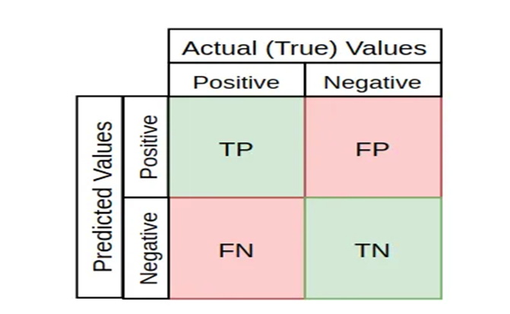
Confusion matrix :
1.TP:True positive :this means person have disease and the model gave the result as migrane affected person
2.FP:False positive : this means person did not have disease and the model gave the result as migrane affected person
3.TN:TRUE NEGATIVE :this means person have disease and the model gave the result as not a migrane affected person
4.FN:FALSE NEGATIVE :this means person did not have disease and the model gave the result as not a migrane affected person

Slide 13
Dataset;
Healthy Samples: 964
Migraine samples: 858
Testing: 170 healthy ,192 Migrane
 | Alex net |  | VGG16 |  | Resnet |  | Proposed CNN
 | 0 | 1 | 0 | 1 | 0 | 1 | 0 | 1
0 | 176 | 16 | 181 | 11 | 174 | 18 | 186 | 6
1 | 10 | 160 | 6 | 164 | 10 | 160 | 8 | 162

Slide 14

to measure the parameters for proposed model

Slide 15
Performance metric comparison with Adams optimizer
 | Validation Accuracy | Test Accuracy | Precision | Recall | F1 score
Alexnet | 92.7 | 92.80 | 91.66 | 94.62 | 93.11
VGG16 | 93.3 | 95.30 | 94.22 | 96.79 | 95.48
ResNet50 | 93.1 | 92.21 | 90.66 | 94.50 | 92.54
Proposed CNN | 95.3 | 96.12 | 96.20 | 96.81 | 97.00

Slide 16
References
Caliskan, A. and Rencuzogullari, S.: Transfer learning to detect neonatal seizure from electroencephalography signals. Neural Computing and Applications. 33(18), 12087-12101 (2021).
Byeon, Y.H., Pan, S.B. and Kwak, K.C.: Intelligent deep models based on scalograms of electrocardiogram signals for biometrics. Sensors. 19(4), 935 (2019).
Krizhevsky, A., Sutskever, I. and Hinton, G.E.: ImageNet classification with deep convolutional neural networks. Advances in neural information processing systems. 25, 1097-1105 (2012).
Prabhakara Rao, A., Prasanna Kumar, G., Ranjan, R., Venkata Subba Rao, M., Srinivasulu, M. and Sravya, E.: Schizophrenia Identification Through Deep Learning on Spectrogram Images. In International Conference on Cognitive Computing and Cyber Physical Systems. Cham: Springer Nature Switzerland. 536, 3-11 (2023).
Padmavathy, N. and Srilakshmi, G.: Approaches to Detect Migraine using EEG Signals: A Review. Proceedings of the International Conference on Innovative Computing & Communication (ICICC), (2022).
Prasanna Kumar, G., Kiran, K., Penmetsa, K., Indira Priyadarsini, K., Budumuru, P.R. and Srinivas, Y.: Brain Tumor Classification Through MR Imaging: A Comparative Analysis. In International Conference on Cognitive Computing and Cyber Physical Systems. Cham: Springer Nature Switzerland, 536, 446-458 (2023).

Slide 17
Thank You

